Slide 1
Evaluation of CAP Strategic Plans - what to expect
Presentation of the Implementing Regulation (EU) 2022/1475 in relation to evaluation ​of CAP Strategic Plans (Title I)
European Evaluation Helpdesk for the CAP, 2023
evaluation@eucapnetwork.eu
Rue Belliard 12, Brussels, Belgium
Tel. +32 2 808 10 24
https://eu-cap-network.ec.europa.eu/support/evaluation_en

Slide 2
Disclaimer
The content of this training material has been prepared by the EU CAP Network, supported by the European Evaluation Helpdesk for the CAP. The material aims to support capacity building activities in relation to the monitoring and evaluation of CAP Strategic Plans. For any use outside of its original intent, or any modifications made to the content of the presentation, prior written permission must be obtained from the European Evaluation Helpdesk for the CAP. Commercial use of this material is strictly prohibited. Please contact: evaluation@eucapnetwork.eu for any questions in this respect.
The European Evaluation Helpdesk for the CAP makes no claims, promises, or guarantees about the accuracy, completeness, or adequacy of the content of the presentation and expressly disclaims liability for any errors or omissions in such content.

Slide 3
GUIDELINES (2023)
Design of Evaluation Plans
Published on EU CAP Network website: LINK
Guidelines are non-binding in nature
Aim to provide minimum and recommended content for Member States’ Evaluation Plans for the 2023-2027 programming period

Slide 4
Why this Implementing Act and how the negotiations went
Need for a balanced evaluation framework
MS asked for: flexibility and proportionality
And at the same time MS asked for common understanding and support…

Slide 5
Why, Who, What, How, When

Slide 6
Why evaluate CAP Strategic Plans?

Slide 7
Why evaluate CAP Strategic Plans
Demonstrate progress and achievements
Justify the use of funding
Increase efficiency of policy
Communication between MA and stakeholders, incl. EC
Continuous learning and improvement
Evidence for design of future policy

Slide 8
2014-2022 evaluation framework (CMEF) vs 2023-2027 (PMEF)

Slide 9
Evaluation frameworks evolve…
2 Pillars
Evaluations: PI mainly EU - PII in MS
Compliance
Analysis by Focus Area / RD priority
Common Evaluation Questions (CEQs)
Judgement criteria and indicators
Interim evaluations (2017, 2019)
Some quantification
1 CAP
Evaluations: MS + EU
Performance (Results)
Analysis by relevant SO or combination
No CEQs
Key evaluation elements, factors of success, indicators (Annex I, SPR)
No obligatory MS interim evaluations
More quantification and net effects
CMEF
PMEF
Notes:
More quantitication and net effects, mention under performance

Slide 10
What does moving toward a performance-oriented CAP mean?
Performance report (2027)
Green Deal reporting (2023, 2025)
Performance report (2031)
Annual Programme Statement (Annex XII)
REPORTING ON PERFORMANCE
Action plan for remedial actions
Performance review
Interim evaluations (CAP Plan)
Interim evaluation (2026)
Annual review meetings
POLICY IMPLEMENTATION
EVALUATION
Performance Report
Annual Monitoring Committee
Ex-post evaluation
PLANNING
SWOT, needs assessment
CAP Plan assessment and approval
Ex-ante evaluation
Notes:
28 Annual Performance Reports (APR): Output and Result indicators of Annex I
Yearly on 15 Feb. of Financial Year (FY) N+1, for data paid in FY N (and claimed in N-1)
Reports to EP and Council on the CAP and New Delivery Model:
2022 on PMEF
2023 on MS CAP Plans, describing the joint efforts of MS towards the environmental and climate objectives of the CAP
2025 on the operation of the New Delivery Model by MSs and combined contributions of MS strategic plans’ interventions to achieve environmental and climate commitments of the Union
2027 on the first results on the performance of the CAP (interim evaluation)
2031 on the performance of the CAP (ex-post evaluation)

Slide 11
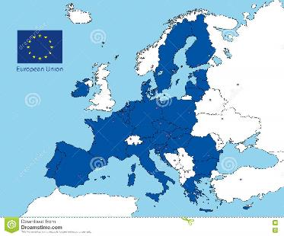
Who evaluates CAP Strategic Plans
MS responsible for :
Ex-ante evaluation, Evaluation Plan, evaluations during implementation and ex-post evaluation of the CAP SP
Covering all relevant SOs
Independent experts (Art. 140, Basic Act)
EC responsible for:
Evaluations based on multi-annual Evaluation Plan
2026 interim evaluation of EAGF and the EAFRD (Art. 141, SPR)

Slide 12
What do MS need to evaluate
Art. 1 and 2
Each Specific Objective (9 SOs + CCO)
Efficiency and simplification
Specific interventions or topics, where relevant
LEADER AV
National CAP Network
AKIS
Environment and climate architecture
Notes:
Increased importance of assessing efficiency. Art 1(3) dedicated to it, while Art 1(1) mentions all the evaluation criteria.
Where relevant (Art. 2)

Slide 13
What do MS evaluate
Each Specific Objective (9 SOs + CCO)
Specific interventions or topics
Efficiency and simplification
Art. 2(a)
Individually or in bundles
According to CAP SP intervention logic
Art. 2(d)
LEADER VA
National CAP Network
AKIS
Environment and climate architecture
Art. 1(3)
Notes:
Increased importance of assessing efficiency. Art 1(3) dedicated to it, while Art 1(1) mentions all the evaluation criteria.

Slide 14
What are the main ingredients of evaluations?
Notes:
How are evaluations done?

Slide 15
How do MS evaluate
Evaluation criteria
Key elements to assess
(effectiveness)
Territorial scope
Factors of success
Evaluation questions
Indicators
(common + specific)
Additional information

Slide 16
MS carry out evaluations using evaluation criteria
Evaluation criteria
Effectiveness and impacts
Efficiency
Relevance
Coherence
Union Value Added
(Better Regulation, Tool #47)
Art. 1 & 2(b)

Slide 17
Evaluation criteria help evaluate the whole flow of the CAP from conception to outcomes …
Other EU policies/ interventions
Impacts
(medium, long-term outcomes)
Needs
Results
(intermediate outcomes)
EU intervention
Objectives
Inputs
Activities
Outputs

Slide 18
Evaluation criteria help evaluate the whole flow of the CAP from conception to outcomes …
Other EU policies/ interventions
Impacts
(medium, long-term outcomes)
External coherence
Actual effects
Needs
Results
(intermediate outcomes)
EU Value Added
Internal coherence
EU intervention
Objectives
Inputs
Activities
Outputs
Relevance
Efficiency
Effectiveness

Slide 19
What do the evaluation criteria mean

Slide 20
Relevance
Assesses the adequacy of the interventions to meet a need and solve a problem (including relevance to changing needs/ contexts)

Slide 21
Relevance
Relationship between the needs and problems at the time of introducing the intervention and during its implementation
Relationship between the current and future needs and problems in the EU and the objectives of the intervention

Slide 22
Effectiveness
Measures how successful EU action has been in achieving or progressing towards its objectives

Slide 23
Effectiveness
How successful EU actions have been in achieving or progressing towards its objectives
Progress made to date
Role of the EU action in delivering the observed changes
Benefits of the EU intervention as they accrue to different stakeholders
Assessed with the use of result and impact indicators

Slide 24
Efficiency
Measures the extent to which the effects/benefits are achieved at a reasonable cost (cost effectiveness)
Simplification for beneficiaries and administration

Slide 25
Efficiency
Resources used by an intervention for the given changes generated by the intervention
Costs of the EU intervention as they accrue to different stakeholders
Compare the identified costs with the benefits that were identified under the effectiveness criterion
Explore the potential for simplification and burden reduction

Slide 26
Coherence
Assesses the synergies of CAP Strategic Plan interventions with each other and with other relevant policies and programmes

Slide 27
Coherence
How well (or not) different interventions, EU/international policies or national/regional/local policy elements work together
‘Internal’ coherence: how the various components of the same EU intervention operate together to achieve its objectives
‘External’ coherence: similar checks can be conducted in relation to other (‘external’) interventions, at different levels
Whether interventions are in line with the objectives of the European Green Deal
Whether the intervention is consistent with the overarching environmental goals (such as the Climate Law) or other policies targeting the environment

Slide 28
Union Value Added
Assesses the changes that are due to the EU intervention, over and above what could reasonably have been expected from national actions by the Member States
Notes:
To clarify as much as possible that assessment of EU added value for MSs would differ from the criteria used by the EC.

Slide 29
Union Value Added
Changes that are due to the EU intervention, over and above what could reasonably have been expected from national actions by the Member States
Principle of subsidiarity:
The EU should only act when the objectives can be better achieved by Union action rather than action by the Member States
Based on information and analysis of impacts that actually occurred

Slide 30
Impacts
Impacts in relation to CAP SP contribution to achieving the CAP general objectives and SOs addressed by the CAP SP
Use O, R, C, I indicators (Annex I) to assess effects
Use also
specific indicators
other quantitative & qualitative info
relevant evaluation criteria
Quantification of impacts (Annex III)
CAP SP overall impact
All evaluation criteria
During implementation
Art. 6
Ex post
Art. 140 (1)

Slide 31
Evaluation criteria (quiz)
Check the benefits of the CAP intervention for different stakeholders by assessing:
Check the costs of the CAP intervention for different stakeholders by assessing:
Effectiveness
Efficiency
Coherence
Relevance

Slide 32
Evaluation criteria (quiz)
Check the link between the current and future needs of the MS and the objectives of CAP intervention, by assessing:
Effectiveness
Efficiency
Coherence
Relevance

Slide 33
Evaluation criteria justify the ‘why’
Demonstrate progress and achievements
Justify the use of funding
Increase efficiency of policy
Effectiveness
Effectiveness
Efficiency
Efficiency
Communication between MA and stakeholders, incl. EC
Continuous learning and improvement
Evidence for design of future policy
Effectiveness, efficiency, relevance, coherence, impacts, value added
Effectiveness, efficiency, relevance, coherence, impacts, value added
Effectiveness, Relevance, Impacts
Notes:
Indicative

Slide 34
MS should not forget the territorial dimension, where relevant
Territorial scope of interventions
Regional evaluations that feed into national ones
National evaluations with input from / collaboration with regions
or both
Art. 2(c)

Slide 35
When assessing effectiveness, MS will use key evaluation elements

Slide 36
Key evaluation elements enable a focus of evaluations
Annex I
SO1
Viable farm income
+
Resilience
SO8
Rural sustainable economy
+
Local development
+
Gender equality and social inclusion
SO6
Reversing biodiversity loss
+
Ecosystem services
SO4
?
CCO
?
Notes:
At least one per SO
Enable focus on key elements of the SO
Focus the collection of evidence

Slide 37
Key evaluation elements enable a focus of evaluations
Annex I
SO1
Viable farm income
+
Resilience
SO8
Rural sustainable economy
+
Local development
+
Gender equality and social inclusion
SO6
Reversing biodiversity loss
+
Ecosystem services
SO4
Climate change mitigation
+
adaptation
CCO
AKIS and digital strategy
Notes:
At least one per SO
Enable focus on key elements of the SO
Focus the collection of evidence

Slide 38
The key elements are accompanied (where relevant) by recommended factors of success
Annex I
SO8
Rural sustainable economy
Rural areas’ economy is growing or, at least, is stable
Sustainable forestry is increasing
Employment rate in rural areas is improving
Enable judgment of whether an objective was achieved
Help assess effectiveness and impacts
Notes:
Enable judgment of whether an objective was achieved
Used to assess effectiveness and impacts
For each evaluation question/key element to assess there is at least one factor of success

Slide 39
Elements and factors of success (example 1)
Annex I
SO1 | Key element to assess | Success factors
To support viable farm income and resilience of the agricultural sector across the Union in order to enhance long-term food security and agricultural diversity as well as to ensure the economic sustainability of agricultural production in the Union | Viable farm income Viable farm income means not only stable income but also fairly distributed income | Agricultural income level in farms supported is increasing or, at least, is stable and disparities between farms and to other economic sectors are decreasing, taking into account general economy trends
 | Resilience Resilience encompasses supporting farmers facing potential risks and specific limitations which can force them to stop agricultural activity | Income support is distributed to farmers most in need

Slide 40
Elements and factors of success (example 2)
Annex I
SO4 | Key element to assess | Success factors
To contribute to climate change mitigation and adaptation, including by reducing greenhouse gas emissions and enhancing carbon sequestration, as well as promote sustainable energy | Climate change mitigation Based on greenhouse gas emissions (GHG) and carbon sequestration | GHG emissions in agriculture are decreasing Soil organic carbon sequestration is increasing or maintained Renewal energy production capacity is increasing
 | Climate change adaptation Based on the resilience of agriculture to climate change | Resilience of agriculture to climate change is increasing

Slide 41
Elements and factors of success (example 3)
Annex I
SO8 | Key element to assess | Success factors
To promote employment, growth, gender equality, including the participation of women in farming, social inclusion and local development in rural areas, including circular bio-economy and sustainable forestry | Rural sustainable economy Based on economic growth and promoting employment | Rural areas’ economy is growing or, at least, is stable and urban-rural gap is decreasing Employment rate in rural areas is improving Bio-economy related business are increasing Sustainable forestry is increasing
 | Local development Provision of local services and infrastructure | Local services and infrastructures are improving
 | Gender equality and social inclusion Promotion of participation of women in farming and the economy, income equity and poverty reduction | Women employment and participation in farming is improving CAP Strategic Plan support is more fairly distributed Rural poverty is decreasing

Slide 42
In order to do evaluations, MS use indicators

Slide 43
Indicators are used to assess the effects of the CAP SP
Assess contribution of CAP SP
Evaluations based on common output, result, impact and context indicators Annex I SPR
Net out impact indicators (Annex III)
Specific indicators, where relevant
Other quantitative and qualitative information, where relevant
Art. 6

Slide 44
Indicators are used to assess the effects of the CAP SP
Assess contribution of CAP SP
Evaluations based on common output, result, impact and context indicators Annex I Reg (EU) 2021/2115
Net out impact indicators (Annex III)
Specific indicators, where relevant
Other quantitative and qualitative information, where relevant
Art. 6

Slide 45
Indicators are used to assess the effects of the CAP SP
Assess contribution of CAP SP
Evaluations based on common output, result, impact and context indicators Annex I Reg (EU) 2021/2115
Net out impact indicators (Annex III)
Specific indicators, where relevant
Other quantitative and qualitative information, where relevant
Art. 6

Slide 46
Annex III
Impact indicators

Slide 47
When do MS evaluate
2023
2024
2025
2026
2027
2028
2029
2030
2031
Summary Reports on the CAP Strategic Plan (2023, 2025, 2027, 2031)
EU level
Annual review meetings
Biennial performance review
Interim evaluation 2026
national level
CAP SP development
CAP Strategic Plan implementation
Ex ante evaluations
Ongoing assessment of the CAP SP in the implementation period (2023-2030)
Ex post evaluation (2031)
Annual Performance Reports
Monitoring

Slide 48
Where does it all come together?
What
How
Why
When
Who
Evaluation Plan
Art. 4

Slide 49
What is the purpose of the Evaluation Plan?

Slide 50
Evaluation Plan: purpose
Helps meet evaluation requirements
Offers info on planned evaluations and ex post
Makes possible that all appropriate evaluation activities will take place
Ensures sufficient resources available for evaluation
Ensure required data available on time and with quality

Slide 51
Evaluations plans are not unique for the CAP

Slide 52
Examples of Evaluation Plans
Interreg
Atlantic Area programme

Slide 53
Examples of Evaluation Plans
ESF
Programme for Employability, Inclusion and Learning 2014–2020, Ireland

Slide 54
Examples of Evaluation Plans
New Zealand
Foreign trade aid programme

Slide 55
What is the role of MS and what is the role of the European Commission in evaluation planning?

Slide 56
Exercise: who does what?
Draw an EP
Consult the CAP SP intervention logic
Approve the EP
Submit EP to the Monitoring Committee
Give opinion on the EP
Inform on EP amendments
Approve EP amendments
Reporting on evaluations
Share evaluations
Share syntheses of evaluations

Slide 57
Evaluation Plan: role of MS
Draw an EP according to the CAP SP intervention logic
MS share info with EC:
Progress in carrying out evaluations
Syntheses of evaluations
Follow-up of findings
Amendments to the EP
Art. 4
Art. 5

Slide 58
Evaluation Plan: role of EC
Basic Act, Art. 140 (5)
Understand
Submitted to Monitoring Committee one year after CAP SP approval
NO need for EC approval
Use
Give opinion
Notes:
Pursuant to Articles 124(3), point (d), and 124(4), point (c), of Regulation (EU) 2021/2115, the monitoring committee is to examine the progress made in carrying out the evaluations, syntheses of evaluations and any follow-up given to findings as well as it is to give its opinion to the evaluation plan and the amendments thereof. As the EC is part of the MC, it can also give opinion.

Slide 59
Evaluation Plan : role of EC
Evaluation Plans submitted to EC one year after CAP SP adoption (no approval)
You will be consulted within the Monitoring Committee
Please check the completeness (Annex II of the IA)
Please check the content (in case of questions, ask @AGRI EVALUATION)
In case MS proposes not to evaluate a particular SO → let us know @AGRI EVALUATION

Slide 60
Annex II
Content of the Evaluation Plan

Slide 61
Evaluation Plan: structure
Objectives and needs
Governance and coordination
Stakeholder mapping
Timeline
Data and information
Communica-tion and follow up
Resources, technical support, capacity building
Annex II

Slide 62
Evaluation Plan section by section

Slide 63
Objectives and needs
Scope: national, regional, thematic
Needs: CAP SP intervention logic + stakeholders
Evaluation activities:
Monitoring and evaluation systems
Evaluations
Capacity building
Notes:
The objectives of the Evaluation Plan may cover one or more of three levels:
a strategic level, where evaluations reflect the national level situation in terms of assessing the contribution of the CAP Strategic Plan to achieving the CAP general objectives and the Specific Objectives (SO) addressed by the CAP Strategic Plan;
a regional level, where evaluations may assess the interventions of CAP Strategic Plans implemented at regional or local level;
a thematic level, where evaluations may assess a specific topic of interest or priority to the Member State.

Slide 64
Governance and coordination
Monitoring and evaluation arrangements: the system of actors, activities and mechanisms that is set up to monitor and assess the implementation of CAP SPs
Bodies involved may include:
MA
MC
National CAP Network
PA
Regional authorities, where relevant
other relevant bodies, e.g. evaluation unit, advisory institutes, evaluation steering group, technical working groups
Notes:
Regional: where relevant, and in accordance with the principle of shared management, the regions can be involved in the design of the Evaluation Plan and in the monitoring and evaluation of regional interventions of the CAP Strategic Plan (paragraph 120, Baci Act)

Slide 65
Governance and coordination
Who are the main actors involved in evaluations? (video)

Slide 66
Stakeholder mapping
Art. 4b
Who is important and for what reason
Relevant stakeholders:
up to the MS
for specific activities
outside MC, where relevant
Capacity building needs
First identify, then prioritise (power vs interest)

Slide 67
Examples of stakeholders per SO
SO2
Representative of agricultural machinery providers
Representatives of banks
Head of regional authority responsible for farm investments
Researcher with substantial experience in the CAP’s role in farm competitiveness
SO1
Head of PA department responsible for direct payments
Head of PA IT department
Head of Ministry department responsible for Pillar 1
Representative of farmers' union
Representative of agricultural chamber
Representative of public agricultural insurance agency
Representative of private insurance companies
Researcher with substantial experience in analysing the CAP's role in income support
Researcher with substantial experience in risk management in agriculture

Slide 68
What is the definition for stakeholders?
Any group or individual who is affected by or can affect the achievement of an organization’s objectives
Freeman, 1984
People who have a stake or a vested interest in the program, policy, or product being evaluated ... and therefore also have a stake in the evaluation
Greene, 2005
Anyone who makes decisions or desires information about a program (or other evaluand) or is affected by the program or its evaluation
Bryson et al., 2011

Slide 69
Mapping vs Engagement
Mapping
Engagement
Identify them
Who are they?
Understand them
How can they affect?
How can they be affected?
What info do they need?
Engage them
Why?
Who?
When?
How?

Slide 70
How to understand stakeholders? Interests vs Power
INTEREST | HIGH | LOW POWER – HIGH INTEREST Interest can be positive or negative. Keep well informed. Tailor information to their needs. Try to increase positive interest and build trust. Consult regarding the quality of evaluations and the plausibility of their findings. Use as technical advisors | HIGH POWER – HIGH INTEREST Interest can be positive or negative. Engage them in evaluation governance. Provide them with regular and detailed information on the evaluation activities and their findings. Assess their needs related to evaluation activities. Improve their capacity for evaluation, where relevant
 | LOW | LOW POWER – LOW INTEREST Provide them with general information and main findings of the evaluations. Try to increase positive interest and build trust. Consult for specific issues, if relevant. | HIGH POWER – LOW INTEREST Interest can be positive or negative. Keep well informed. Tailor information to their needs. Try to increase positive interest. Consult regarding the quality of evaluations and the plausibility of their findings. Use as technical advisors
 |  | LOW | HIGH
 |  | POWER

Slide 71
Why and who to engage?
INTEREST | HIGH | INVOLVE CAP SP Beneficiaries (non-farmers) Farm Advisors Consultants Environmental NGOs | COLLABORATE Paying Agency Intermediate Bodies Regional Authorities Ministry high-level officials Strong farmer unions
 | LOW | INFORM General public | CONSULT Key researchers and academics Other NGOs
 |  | LOW | HIGH
 |  | POWER

Slide 72
When to engage stakeholders? An example
Intermediate Bodies
Regional Authorities
Paying Agency
Researchers, Academics
Collaborate
Consult
Define evaluation activities
Define evaluation timeline
Draft general evaluation framework
Make data arrangements
Draft ToR
Collaborate
Involve
Politicians
Strong Farmer Unions
Environment NGOs
Farm Advisors,
Consultants
Involve

Slide 73
How to engage them?
Level of engagement | Engagement tools
Collaborate | Set-up an Evaluation Steering Group. Managing Authority should also participate
Involve | Set-up an Evaluation Advisory Group. Managing Authority’s role better limited to setting the legal context and clarifying the areas of concern and current issues for which advice is sought
Consult | Set-up ad hoc focus groups or Sounding Board consultations
Inform | Regularly publish information at every stage of the evaluations: planning, progress, findings and recommendations, follow-up

Slide 74
Timeline
Indicative
Programming cycle
Evaluations and evaluation support studies
Reasoning of choices made

Slide 75
Timeline
Take into account evaluation needs and CAP SP intervention logic
Each SO
SO in bundles
Justify if not assessed
Where relevant:
Environment and climate architecture
Added value of LEADER
CAP networks
AKIS
Studies (e.g. methodologies, data)
Art. 2a
Art. 2d

Slide 76
Timeline (example)
2023
2024
2025
2026
2027
2028
2029
2030
2031
Ongoing evaluations: SOs and specific topics
Impact evaluation (ex post)
Types of evaluation
Support studies, analytical and research activities
Data preparation
Identifying and solving data gaps
Evaluation activities
Capacity building
Relevance
Effectiveness
Impact
Evaluation criteria
(as relevant)
Efficiency
EU added value
Coherence
Notes:
Stress MS do not have to include evaluation criteria in the EP

Slide 77
Data and information
Art. 7(1)&(2)
Data sources / data systems
Data availability/ data gaps
Institutional arrangements for data provision and quality

Slide 78
Data and information
Institutional
PA/ implementing bodies
National/ regional statistical units
Research centres
Data providers
Other
Arrangements
System
Data quality control
IT system in time
Collection process, e.g. from applications
Links to R indicators / SOs
Data gaps
Data availability
Needs
Elements to assess
Evaluation topics
Types of interventions (RD, DPs, Sectoral)
Indicators
Data
Sources
PA
FADN
FSS
Other

Slide 79
Data and information
Institutional
PA/ implementing bodies
Statistical units
Research centres
Data providers
Other
Arrangements
System
Data quality control
IT system in time
Collection process, e.g. from applications
Links to indicators
Data gaps
Data availability
Needs
e.g.
evaluation topics
indicators
Data
Sources
PA
FADN
FSS
Other

Slide 80
Communication and follow up
How do you understand it?
Notes:
Target recipients: evaluation stakeholders at EU, national and regional level, such as policymakers, evaluators, researchers, beneficiaries, and the wider public
Mechanisms: information channels, i.e. the means (e.g. e-mail, internet, intranet, newsletter, events) through which evaluation findings are disseminated
Follow up: this can be done through different mechanisms (e.g. action plans, seminars, workshops, committees, knowledge brokering ) in order to feed lesson learning and recommendations from evaluations back into implementation of the CAP Strategic Plan and to the policy cycle, including the design of future policy. Use of the knowledge generated by evaluation is the key purpose of any evaluation. Use of knowledge must systematically be further analysed and shared. This is one of the functions of the evaluation managers who should act as a knowledge brokers

Slide 81
Communication and follow up
Notes:
Target recipients: evaluation stakeholders at EU, national and regional level, such as policymakers, evaluators, researchers, beneficiaries, and the wider public
Mechanisms: information channels, i.e. the means (e.g. e-mail, internet, intranet, newsletter, events) through which evaluation findings are disseminated
Follow up: this can be done through different mechanisms (e.g. action plans, seminars, workshops, committees, knowledge brokering ) in order to feed lesson learning and recommendations from evaluations back into implementation of the CAP Strategic Plan and to the policy cycle, including the design of future policy. Use of the knowledge generated by evaluation is the key purpose of any evaluation. Use of knowledge must systematically be further analysed and shared. This is one of the functions of the evaluation managers who should act as a knowledge brokers

Slide 82
Communication and follow up
Communication: ensures that evaluation findings (WHAT) are transmitted to the target recipients (WHO), through the right mechanisms (HOW) and at the right time (WHEN)
Follow-up of evaluation results: feed lessons and recommendations back into implementation
Notes:
Target recipients: evaluation stakeholders at EU, national and regional level, such as policymakers, evaluators, researchers, beneficiaries, and the wider public
Mechanisms: information channels, i.e. the means (e.g. e-mail, internet, intranet, newsletter, events) through which evaluation findings are disseminated
Follow up: this can be done through different mechanisms (e.g. action plans, seminars, workshops, committees, knowledge brokering ) in order to feed lesson learning and recommendations from evaluations back into implementation of the CAP Strategic Plan and to the policy cycle, including the design of future policy. Use of the knowledge generated by evaluation is the key purpose of any evaluation. Use of knowledge must systematically be further analysed and shared. This is one of the functions of the evaluation managers who should act as a knowledge brokers

Slide 83
Communication and follow up
Evaluation findings: results of evaluations, incl. conclusions and recommendations
Target recipients: evaluation stakeholders at EU, national and regional level
Mechanisms established: information channels through which evaluation findings are disseminated
Notes:
Target recipients: evaluation stakeholders at EU, national and regional level, such as policymakers, evaluators, researchers, beneficiaries, and the wider public
Mechanisms: information channels, i.e. the means (e.g. e-mail, internet, intranet, newsletter, events) through which evaluation findings are disseminated
Follow up: this can be done through different mechanisms (e.g. action plans, seminars, workshops, committees, knowledge brokering ) in order to feed lesson learning and recommendations from evaluations back into implementation of the CAP Strategic Plan and to the policy cycle, including the design of future policy. Use of the knowledge generated by evaluation is the key purpose of any evaluation. Use of knowledge must systematically be further analysed and shared. This is one of the functions of the evaluation managers who should act as a knowledge brokers

Slide 84
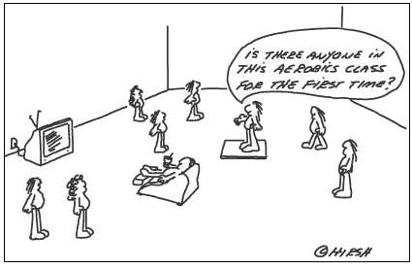
Resources, technical support and capacity building
Art. 7(3),(4),(5)
This Photo by Unknown Author is licensed under CC BY-NC-ND
CAP Networks
Evaluation needs:
- Stakeholders’
- LAGs

Slide 85
Resources, technical support and capacity building
Art. 7(3),(4),(5)
Stakeholders’ evaluation needs → Capacity building plan
LAG evaluation needs → training or other capacity building
Role of CAP Networks (EU/National)
EU Annual Work Programme

Slide 86
Evaluation Plans: follow up
Each year MS will provide EC/you with information on implementation of their Evaluation Plans (Art 5 of IA)
You will be consulted within the Monitoring Committee
Please check and comment (in case of questions, ask @AGRI EVALUATION)
We (A3) will also analyse this information
It can be discussed at the Annual Review Meeting or also at Yearly Capacity Building (EH)

Slide 87
How many of you are also responsible for RDP?
Please don’t forget Chapter 2 of the AIRs
→ Check completeness and coherence

Slide 88
Evaluation Plan: what is new
Evaluation activities
No separate EP section required
Objectives and needs to ensure sufficient and appropriate activities are undertaken
Evaluation framework → PMEF (performance oriented evaluations), factors of success
Contribution to SOs
Specific topics (Leader, national CAP Network, AKIS, environment/climate)
Simplification
Consider previous Pillar 1
Evaluation topics
Stakeholder mapping
New this period
New tools → mind map for identification, power vs interest diagram for prioritisation
Capacity building needs

Slide 89
What else do you want to know?

Slide 90
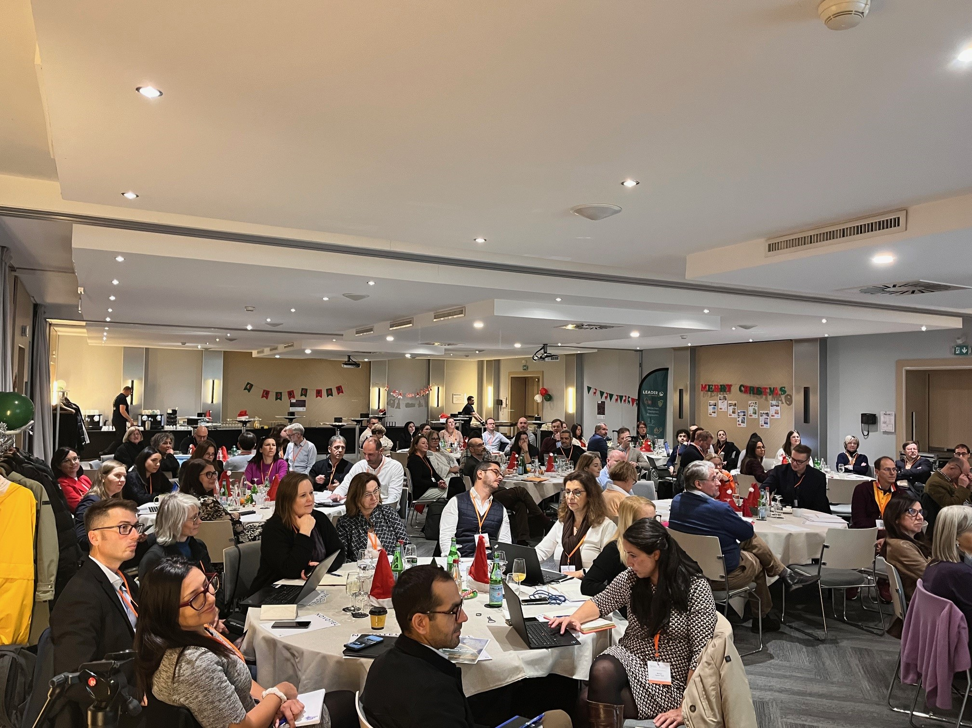
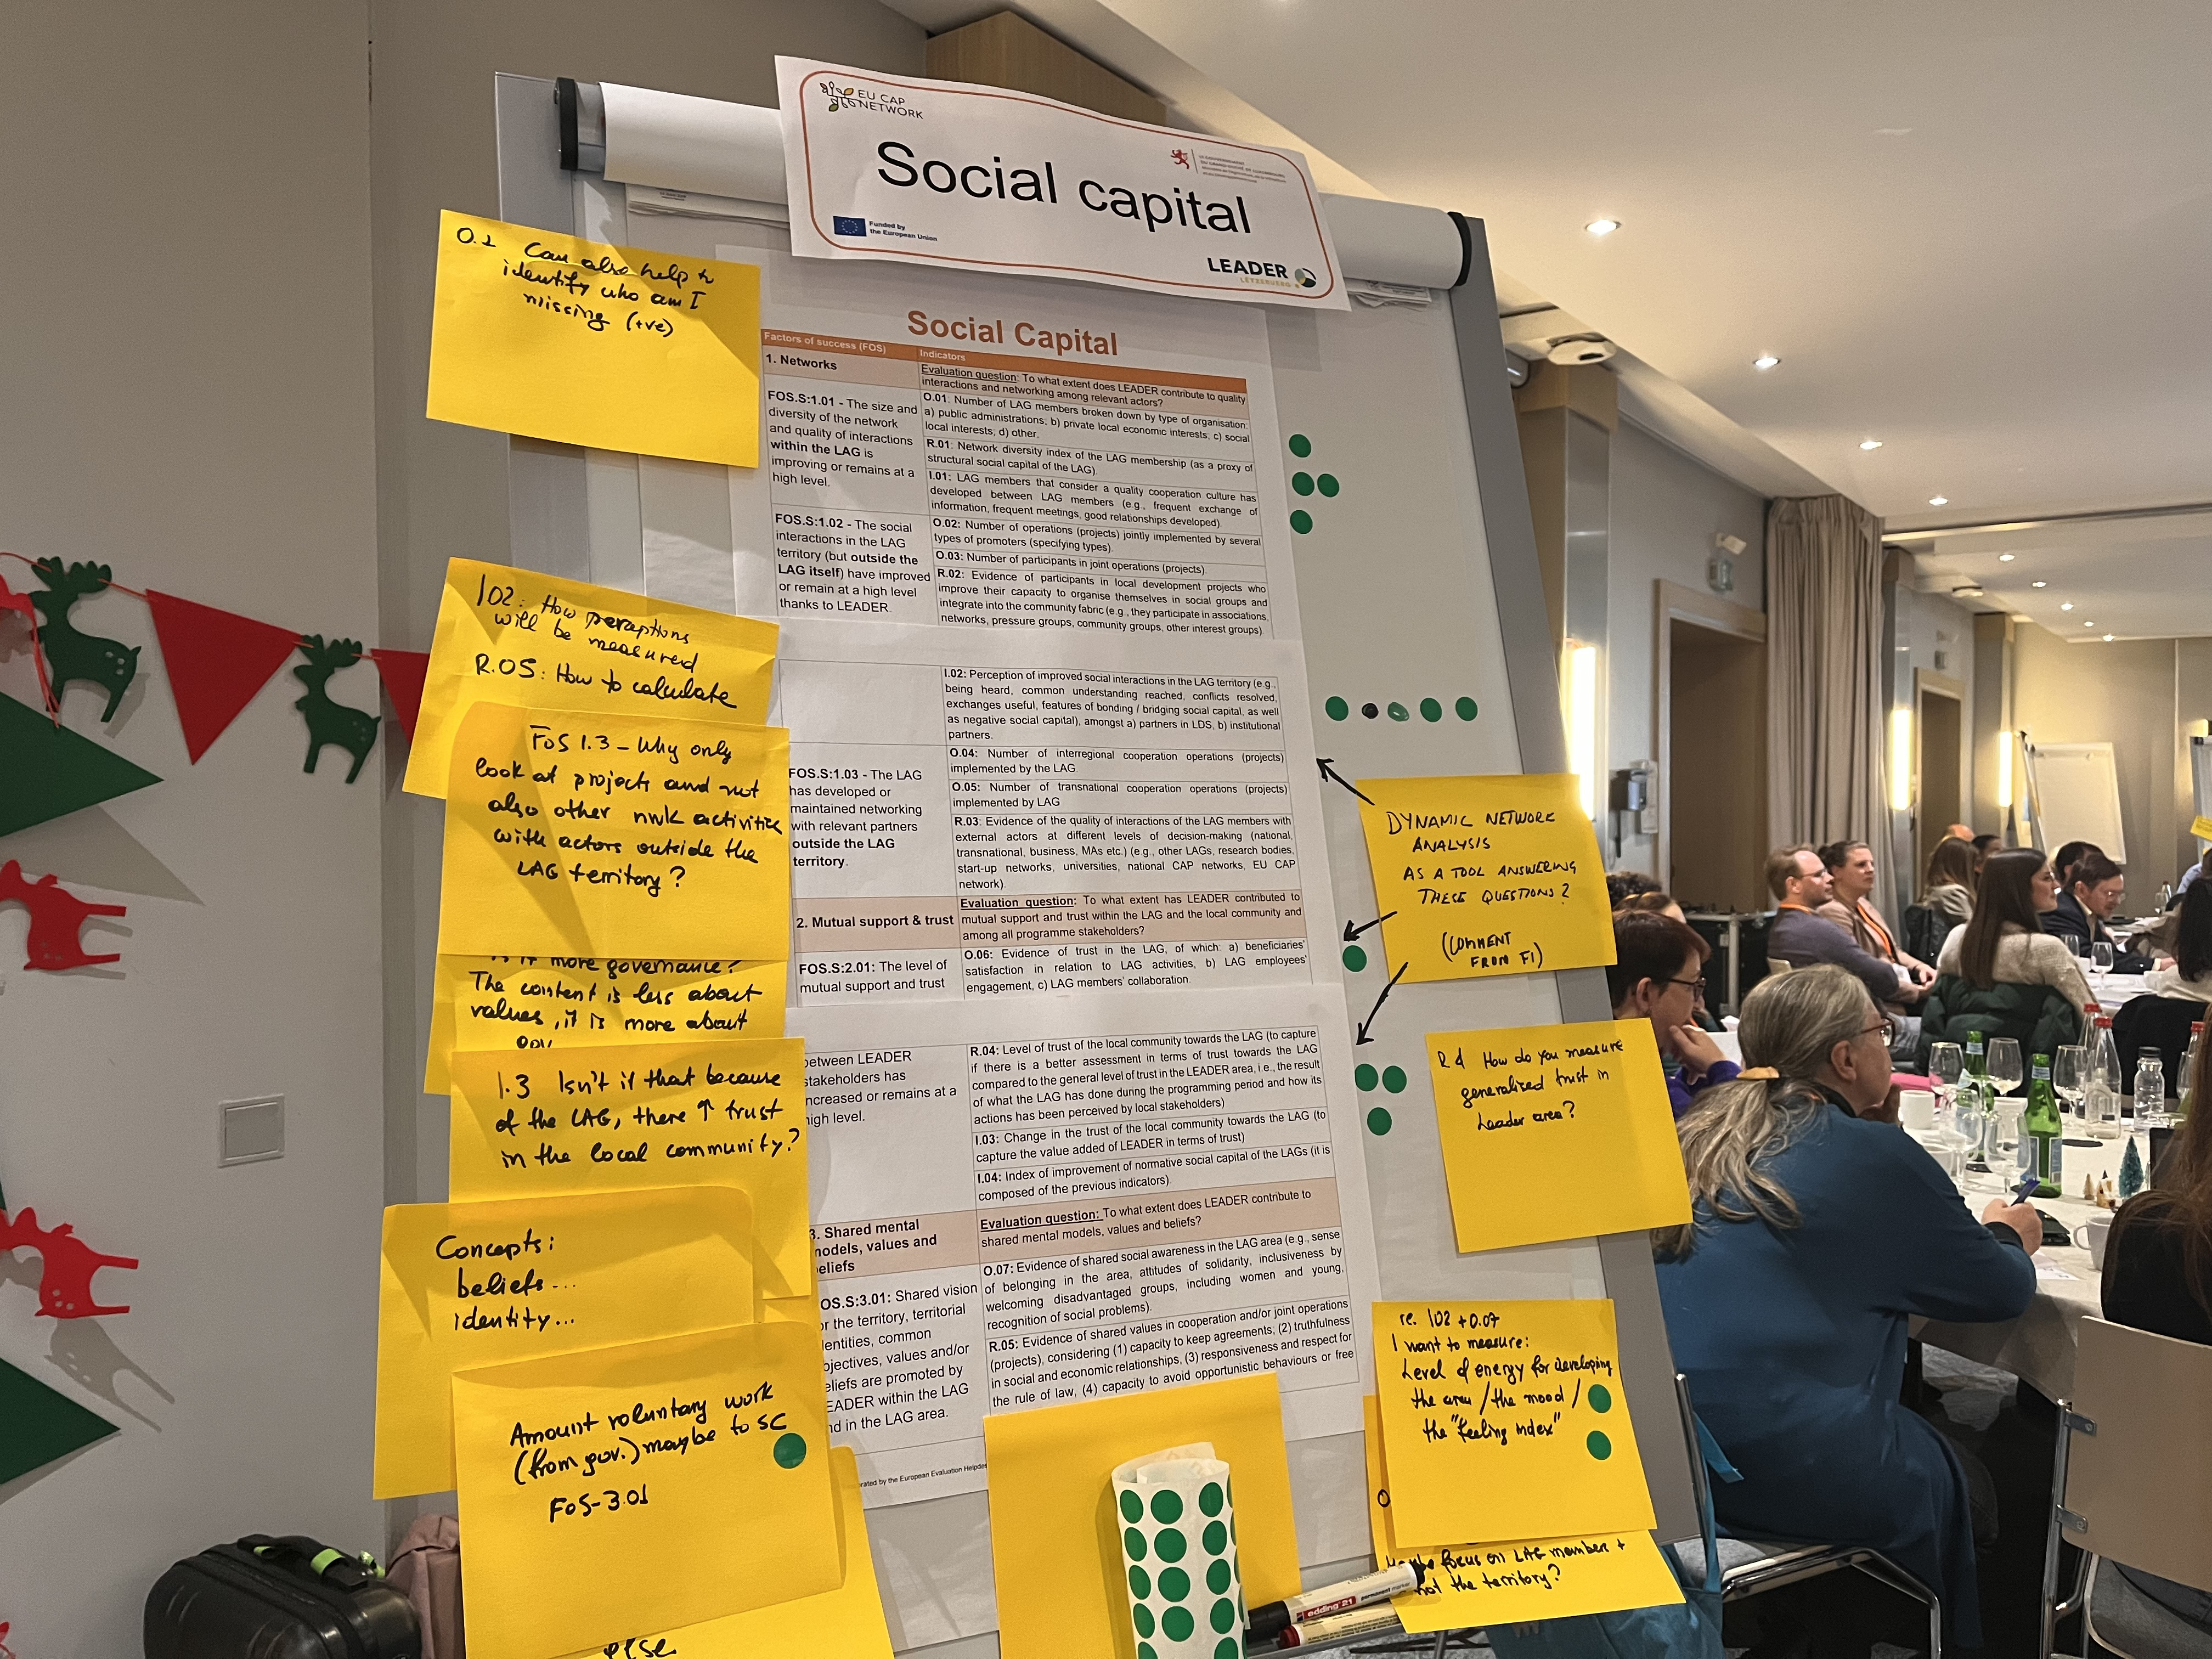
Get in touch
European Evaluation Helpdesk for the CAP
evaluation@eucapnetwork.eu
Rue Belliard 12
Brussels, Belgium
Tel. +32 2 808 10 24
https://eu-cap-network.ec.europa.eu/support/evaluation_en

